Slide 1

Abstractive Tweet Summarisation
Shubham Mondal
MT2022169

Slide 2
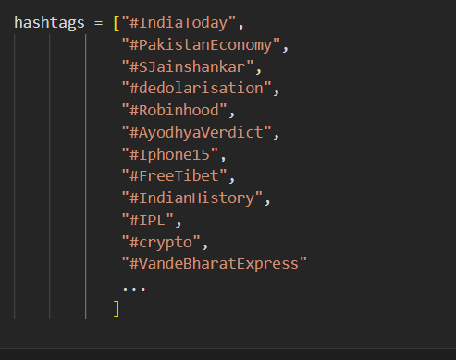
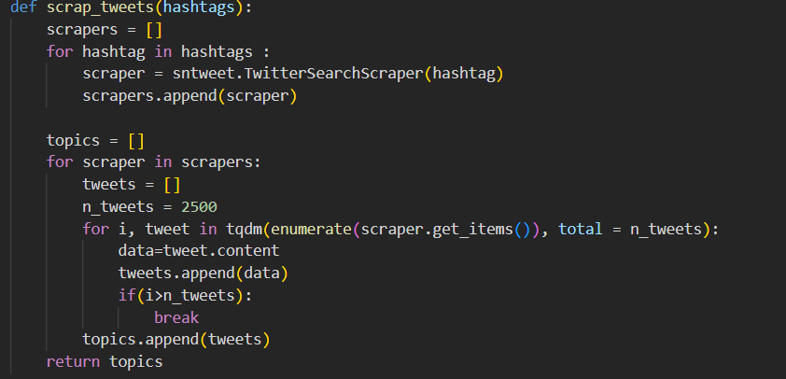
Data Extraction
- Used Snscrape to scrape twitter tweets of trending hashtags

Slide 3
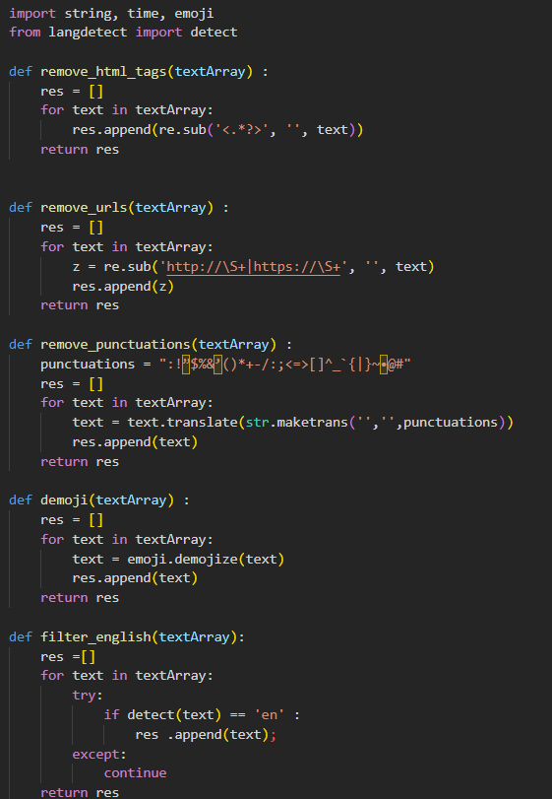
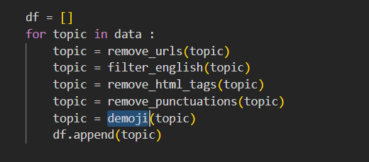
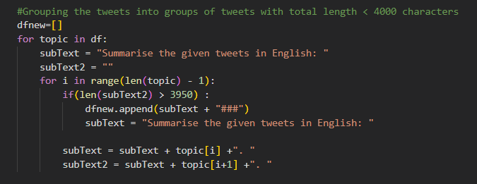
Pre-Processing
Basic Text pre-processing steps were applied on the data before generating summaries
The tweets were also grouped with token size of around 4000 characters and fed to chatgpt to generate summaries.

Slide 4
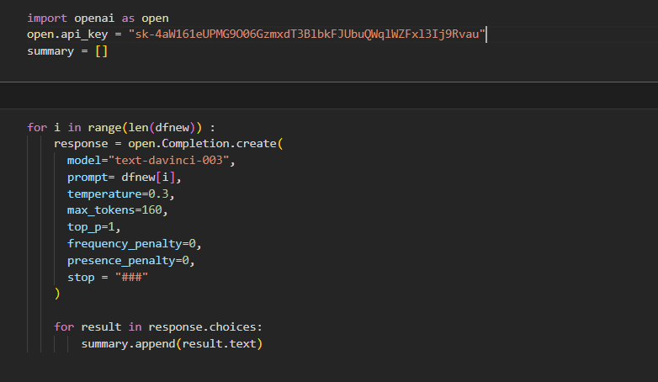
Corpus Generation
Chat-GPT API was used to generate all the summaries to train and finetune different models.
~1189 rows with grouped tweets and summaries were generated

Slide 5
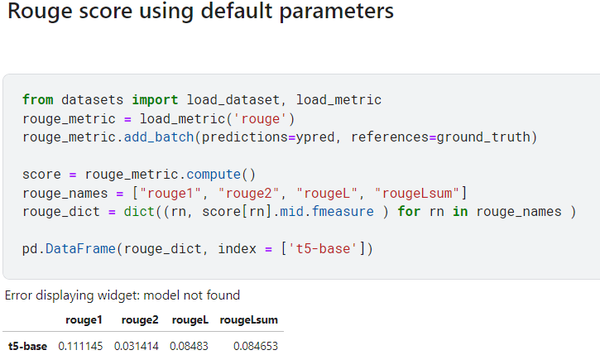
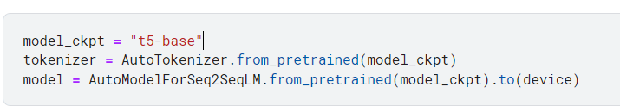
Using Pre-Trained Model T5-base
T5-base with pre-trained embeddings were used to generate summaries.
Rouge Score (rouge1) of ~0.12 was achieved.

Slide 6
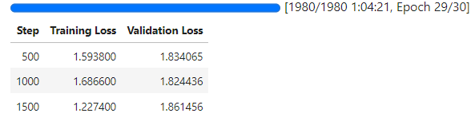
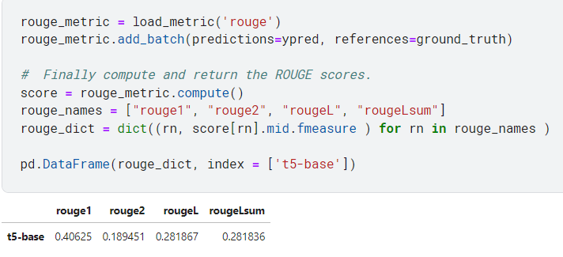
Model T5-base post Fine-tuning
T5-base post finetuning embeddings for 30 epochs.
Gave Rouge Score(rouge1) of ~0.40.

Slide 7
References
T5-base post fineuning embeddings for 30 epochs.
Introduction to Text Summarization with ROUGE Scores | by Tan Pengshi Alvin | Towards Data Science

Slide 8

References
Models - Hugging Face
Introduction to Text Summarization with ROUGE Scores | by Tan Pengshi
T5-base : Hugging face

Slide 9
Thank You

Slide 10
Thank You

